Slide 1
Light-Emitting Diodes (LED)
Lecturer: Mauro Mosca
(www.dieet.unipa.it/tfl)
last release: 02/11/2020
University of Palermo – Master in Electronic Engineering

Slide 2

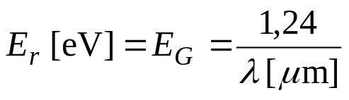
LED: injection luminescence
p
n
E_{C} - E_{V} = hc/λ
E_{C}
E_{F}
E_{F}
E_{V}
p
n
V₀

Slide 3
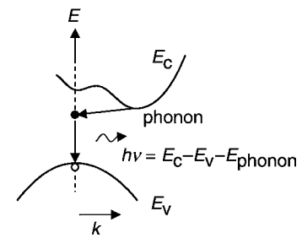
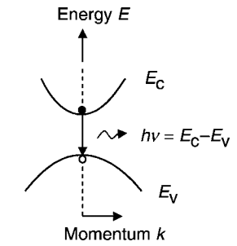
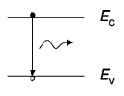

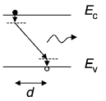

LED: radiative recombination
In order to have a high radiative recombination…
… it is necessary that junctions are high-doped
bimolecular recombination equation

Slide 4
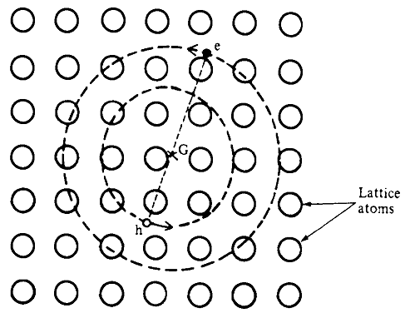


LED: radiative recombination
by excitons

Slide 5
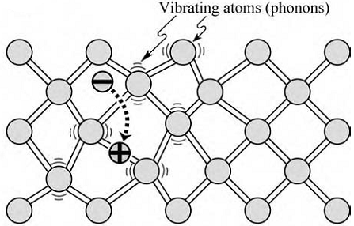
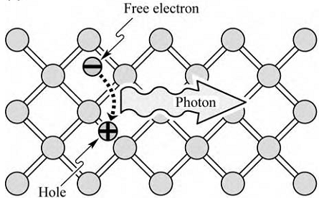
LED:
radiative recombination
NON

Slide 6
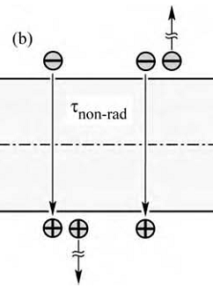

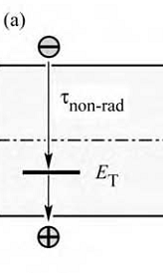





LED: non-radiative recombination
deep-level
Auger
radiant process predominant
at low temperature

Slide 7






Emission linewidths
effective mass
density of states
N(E), Z(E)

Slide 8



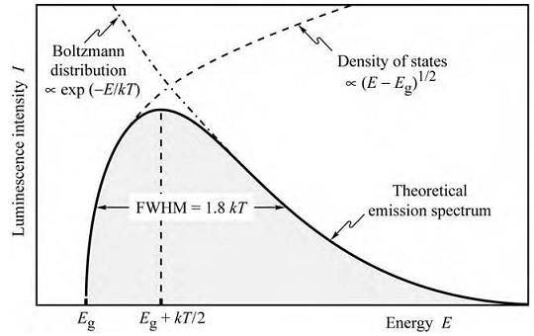
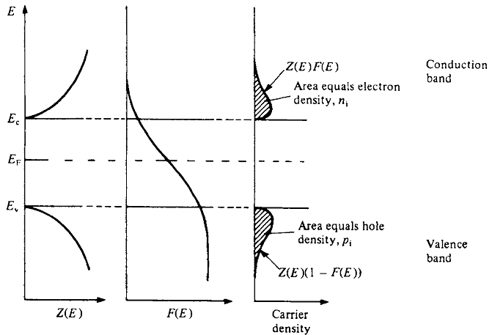

Emission linewidths
Δν = 1.8 kT/h

Slide 9
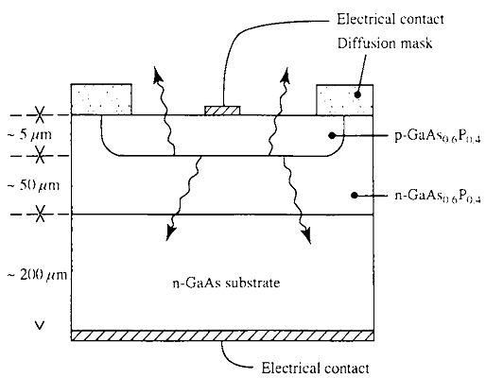
LED construction
recombination close to the junction
less self-absorption
n⁺-p diode
opaque substrate

Slide 10
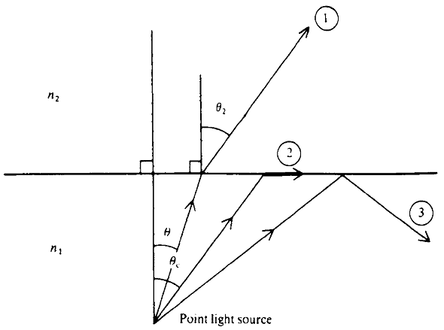
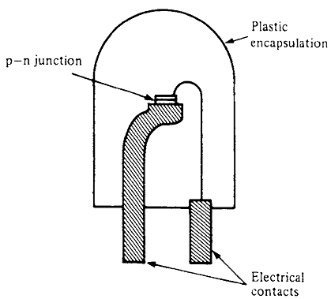
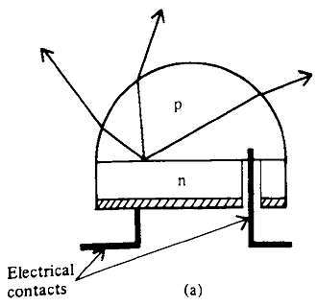

Light extraction
total internal reflection
n_{epoxy} (≈1.5) > n_{air}
ENCAPSULATION
TECHNIQUE
n₁ – n_{epoxy} < n₁ - n_{air}
F_{epoxy} > F_{air}
n₁sinθ₁ = n₂sin(90°)
θ_{c} = arcsin(n₂/n₁)
losses epoxy/air interface
minimized by moulding the epoxy into an hemispherical shape
most rays strike the surface at an angle less than the critical angle

Slide 11
Exercise
Calculate the fraction of light transmitted by isotropic radiation F originated from a GaAs LED. Perform the same calculation for a LED encapsulated in an epoxy resin with an index of 1.5.
For the GaAs, consider n = 3.6
Solution:
F = 0.013 (1,3%) for GaAs/air
F = 0.036 (3,6%) for GaAs/epoxy/air

Slide 12
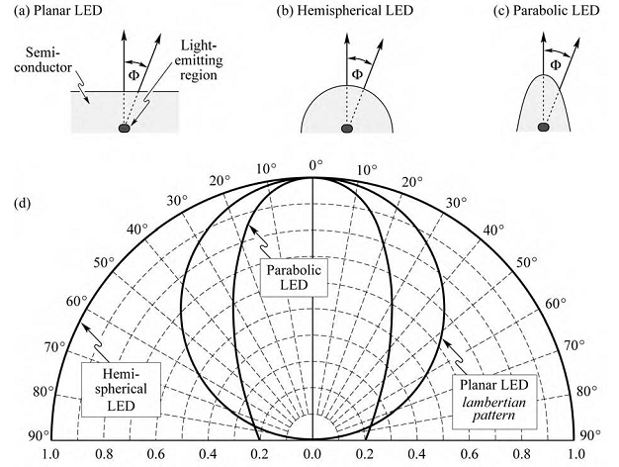

Radiation pattern
0.5

Slide 13
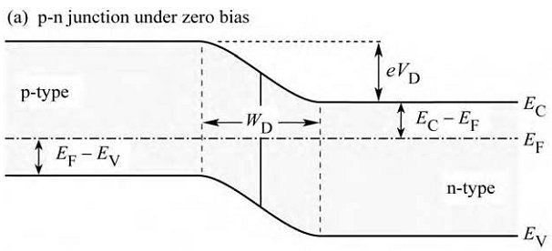
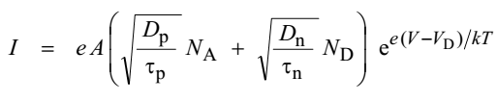

Electrical properties
diffusion voltage (or built-in voltage, or potential barrier)

Slide 14
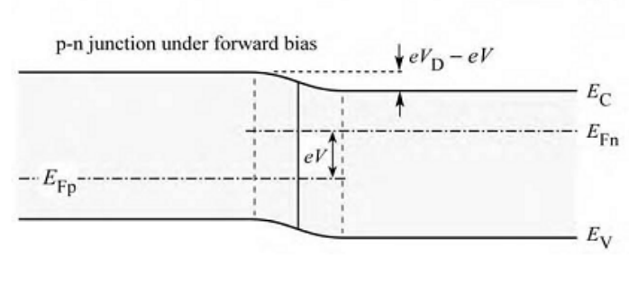




Electrical properties
E_{g}

Slide 15
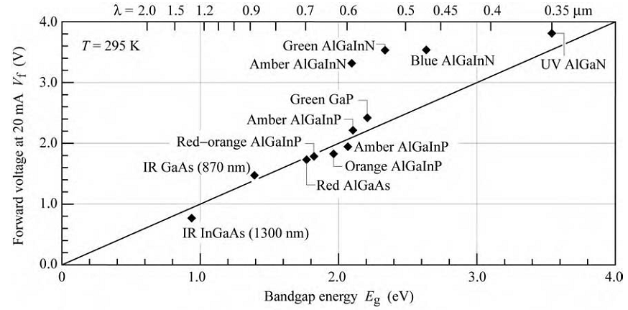
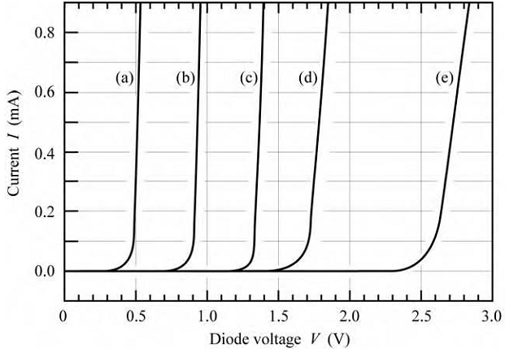
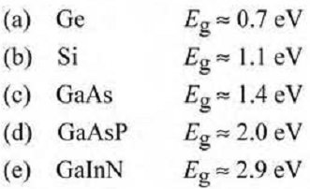
Electrical properties
nitride-based LEDs
AlGaInP-based LEDs

Slide 16

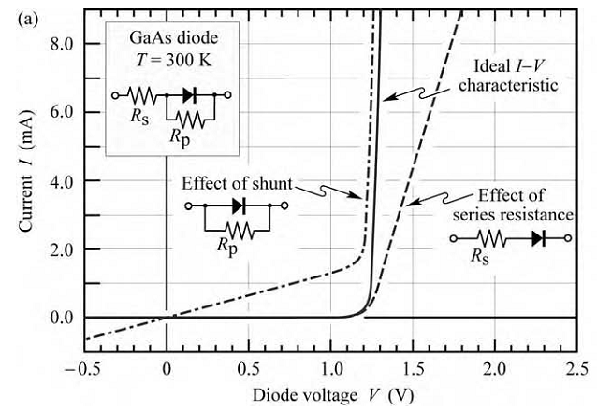
Electrical properties

Slide 17
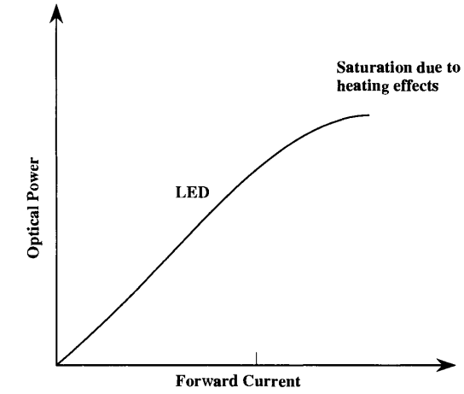
Light-current characteristic

Slide 18
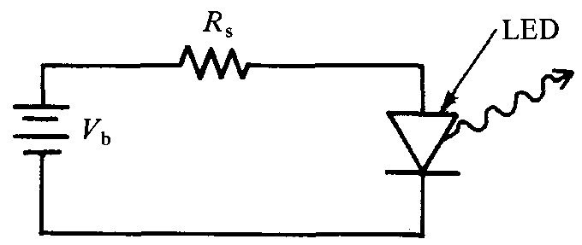
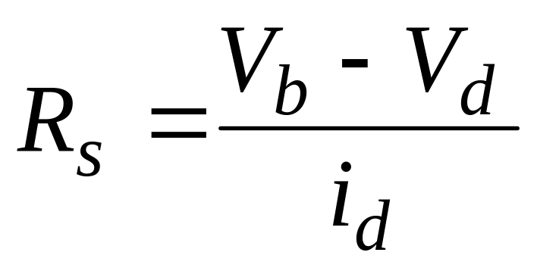
LED drive circuit for d.c. operations
+
V_{d}

Slide 19
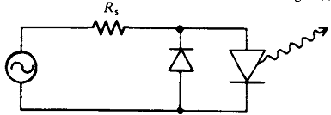
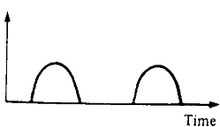
LED drive circuit for a.c. operations

Slide 20
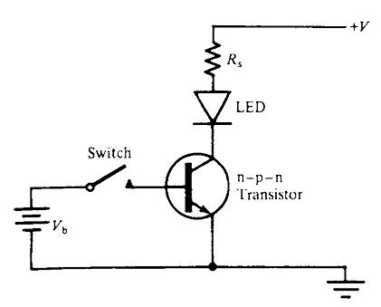
LED on/off modulation circuit

Slide 21
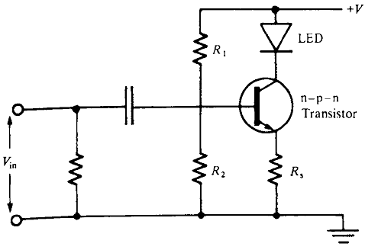
LED linear modulation circuit

Slide 22
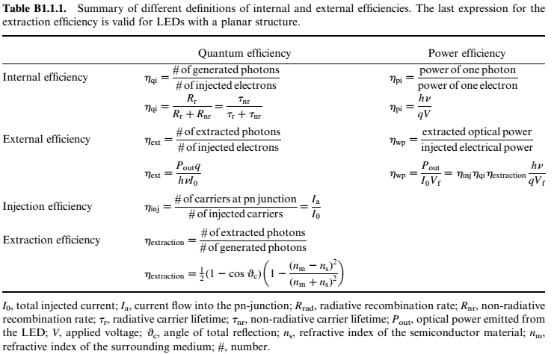



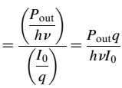




Efficiency

Slide 23
Difficult to obtain high efficiency?
large active region (minority carriers limited
only by diffusion)
radiative recombination speed proportional to
carrier concentration: R = Bnp
(if the active region is large, the concentration –
that is, the number of charges per unit of volume –
is small)
non-localized carriers (unless…)

Slide 24
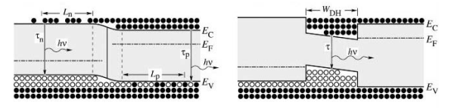
Double heterostructure
HOMOJUNCTION
HETEROJUNCTION
charges distributed over a distance
equal to the diffusion length
(a)
(b)
charges confined within the
narrowest bandgap region

Slide 25
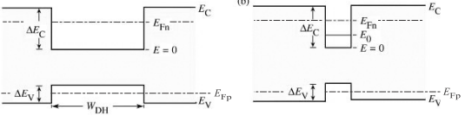
Quantum-well
DOUBLE HETEROSTRUCTURE
QUANTUM-WELL STRUCTURE
localization increases
self-absorption decreases
(thin active region)

Slide 26

Separate Confinement Heterostructures (SCHs)
In a double heterostructure, the narrower bandgap region usually also has a higher refractive index
confined charges
GRaded INdex Separate Confinement
Heterostructure (GRINSCH)
confined photons
Separate Confinement
Heterostructure (SCH)
even photons are confined !!
improves the overlap between the optical wave
and quantum well regions

Slide 27
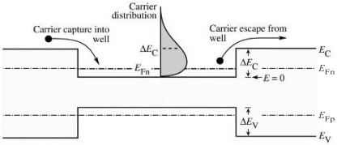
Carrier Loss
saturation of the
optical intensity
high current
injection
Analogy of the bucket of water...
too much water and the bucket overflows!
To limit overflow, the current injection areas can be sized
so that they have large areas, which means large electrical contacts

Slide 28
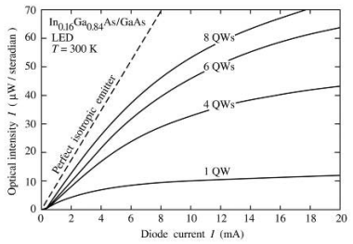
Carrier loss
Using a large number of QWs, the overflow is more limited
carrier
overflow
Optical intensity emitted by an LED in In_{0.16}Ga_{0.84}As/GaAs with active regions consisting of 1, 4, 6 and 8 quantum wells and theoretical intensity of a perfect isotropic emitter (in dashed line)

Slide 29
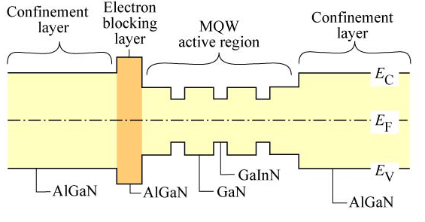
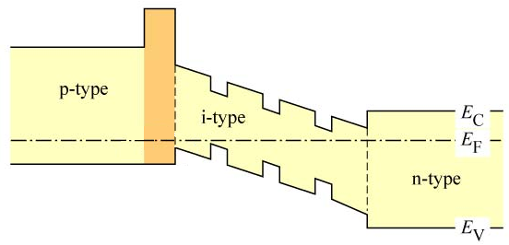
Electron-blocking layer
no barrier to the
flow of holes
undoped structure
doped structure

Slide 30

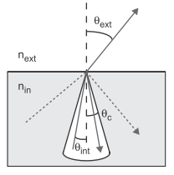

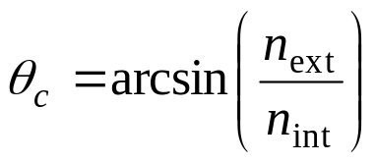

Light extraction: light escape cone
η_{extr} ≈ γ_{refl}
problem of re-absorption
problem of the internal reflection at the interface semiconductor–air.
shadowing of the emission by the top contact
absorption factor
reflection factor
shadowing factor

Slide 31
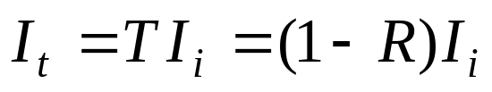
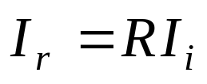
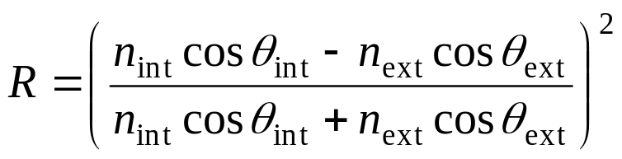
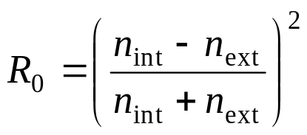
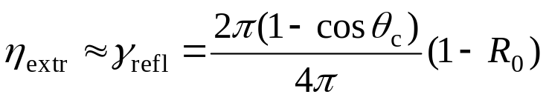
Light extraction: light escape cone
For θ_{int} ≤ θ_{c}
TE (s) polarization:
(θ_{i} = 0)
for isotropic emission and R ~ R₀

Slide 32
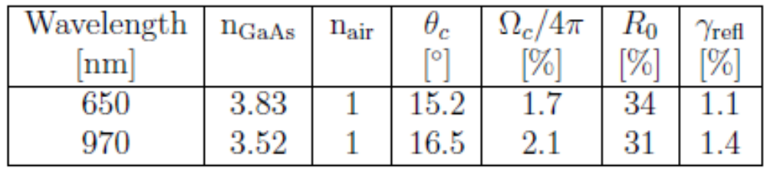
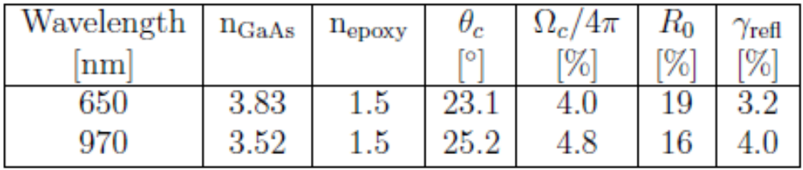
Light extraction: light escape cone
Tab. 1 – Extraction properties for interface GaAs–air at 650 and 970 nm
critical angle higher in the presence of epoxy (lower index difference)
Tab. 2 – Extraction properties for interface GaAs–epoxy at 650 and 970 nm
the epoxy can be modeled in the shape of a hemisphere so that the light rays coming from the center are practically perpendicular to the surface of the epoxy
high epoxy-air critical angle (epoxy index close to that of the air)

Slide 33
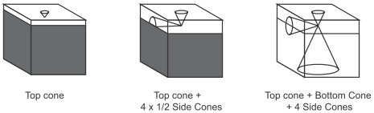
Optimization Standard Geometry
active region close to the surface
efficiency increases by a factor of
efficiency increases by a factor of 6
?
3
absorbing
substrate
Light extraction cones for different LED geometries (based on standard rectangular
base parallelepiped geometry):
(a) absorbing substrate with with thin window layer
(b) absorbing substrate with thick window layer
(c) transparent substrate with thick window layer

Slide 34
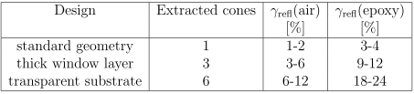

Optimization Standard Geometry
Extraction efficiency increasing through
thick upper window and transparent substrate
β = (π /2 – θ_{c}) / 2
Cross-section schematics of ideal geometries; sphere with
point source (left), hemisphere (middle) and a truncated cone (right)

Slide 35
Techniques to fabricate high-efficiency LEDs
Evolution of external quantum efficiency improvements for LEDs in AlGaInP
(η_{ext} calculated considering the LED immersed in an epoxy dome)
Year | Design | η_{ext} (%)
1990 | DH on GaAs substrate (standard LED) | ≈ 2
1992 | thick GaP window layer | ≥ 6
1994 | transparent GaP substrate | 17,6
1996 | idem | 23,7
1999 | idem + MQW | 32,0

Slide 36


Techniques to fabricate high-efficiency LEDs
Two different generations of amber AlGaInP LEDs by Hewlett-Packard (now Lumileds):
- absorbing GaAs substrate (AS) LED with thick GaP window layer
- wafer-bonded transparent GaP substrate (TS) LED
etching
chimico
wafer
bonding

Slide 37


Techniques to fabricate high-efficiency LEDs:
TIP geometries
η = 55%
TIP geometry devices: (a) InGaN blue LEDs on SiC substrate, marketed under the name “Aton”; (b) Diagram of the path of the rays in the LED
(c) AlGaInP / GaP LEDs; (d) Diagram of the path of the rays in the LED

Slide 38


Techniques to fabricate high-efficiency LEDs:
Thin-film LEDs
bonded on a gold-coated dielectric mirror
a) LEDs with reflecting mirror
η = 72%
epitaxial lift-off
high etching selectivity of AlGaAs alloys in hydrofluoric acid
b) Surface-Textured LEDs
photon recycling
GaN etching
natural lithography

Slide 39



Techniques to fabricate high-efficiency LEDs:
Thin-film LEDs
c) Buried micro-reflector LEDs
(BMR LEDs)
d) Tapered LEDs
must be

Slide 40


Tapered LEDs: photoresist reflow
(a)
(b)

